Slide 1


Introduction to Springpod
Take control of your future

Slide 2

Meet Springpod
Our mission is to transform young people's futures by providing life-changing career experiences and opportunities.

Slide 3
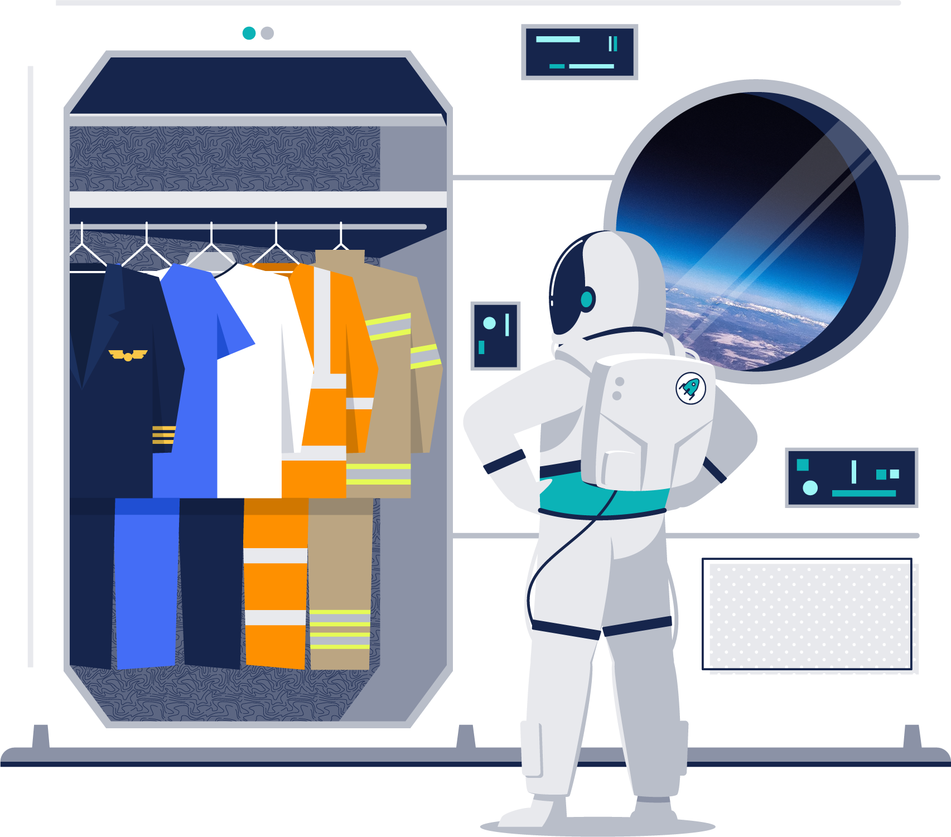


Explore Careers
Explore University
Build Experience

Slide 4
What can you do with Springpod?

Slide 5
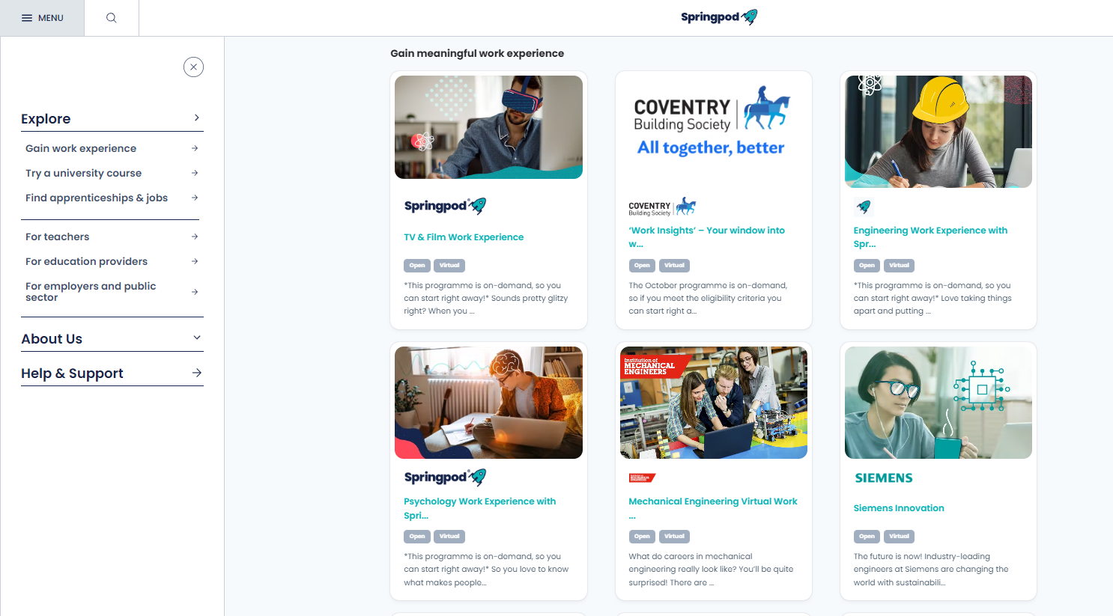
Explore work experience
Self-led and flexible
Live webinars with employers
Get ahead with new skills & knowledge: learn new skills and develop industry knowledge.
Make your CV stand out: gain certificates and experience a range of industries
Click here to view all open opportunities

Slide 6
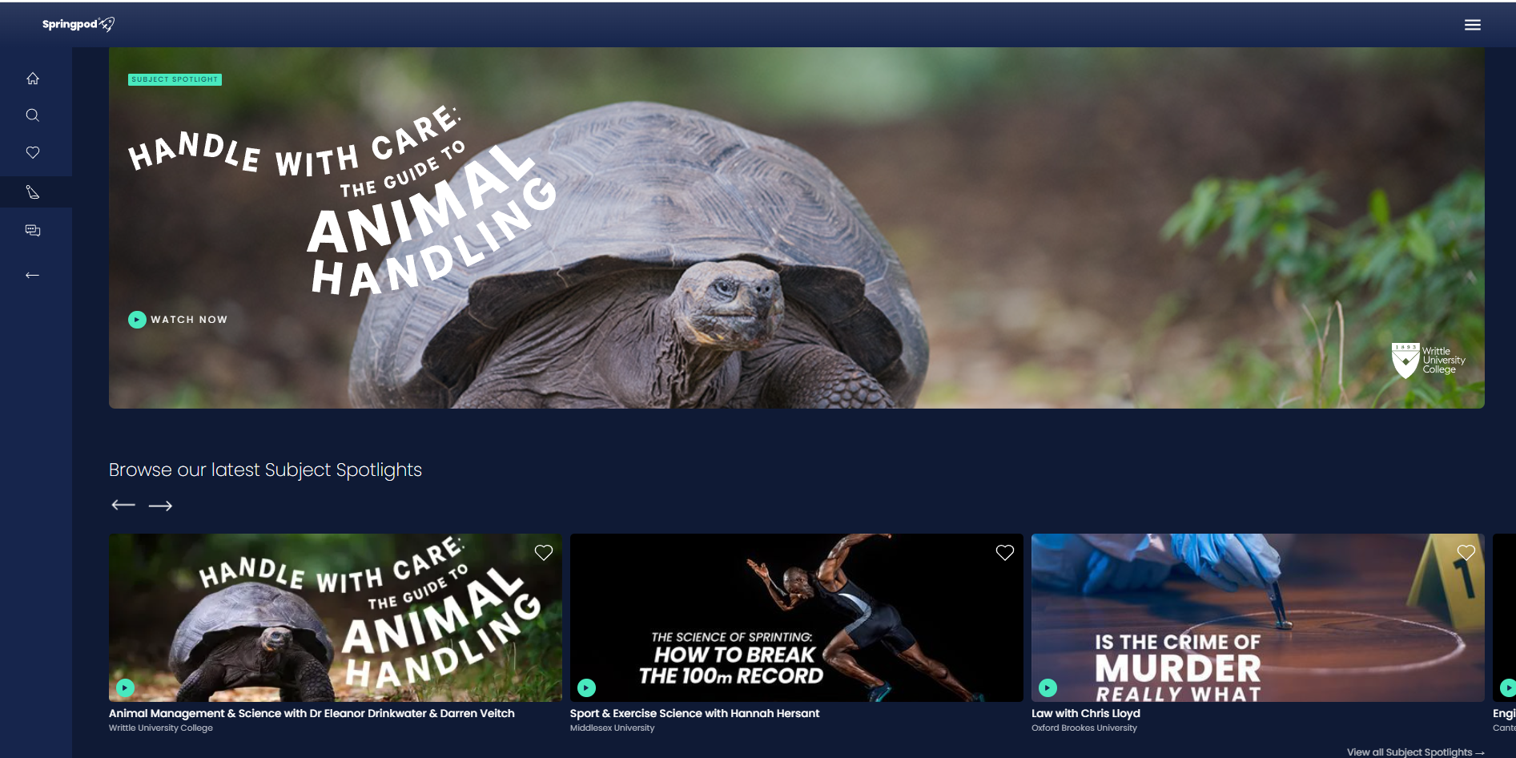
Explore our University Experience Hub
Subject Spotlights:
Try a university degree, before you apply, and make sure it’s the right course for you.
Build your ‘Super-curricular’ to make your personal statement stand out
Click here to explore

Slide 7

Our 5 Top Tips to make the most of Springpod
Keep your profile up to date to ensure you don’t miss out on relevant experiences and then Apply, Apply, Apply!
Plan your schedule in advance and make notes
When completing tasks reflect on your own skills and think about whether or not this career is right for you
Ask questions in live webinars. Make a note of any useful tips and advice throughout
Meet any deadlines set and ask for help if you need it. Make sure you add the experience to your CV and download your certificate

Slide 8
Creating a Springpod account
Take control of your future

Slide 9
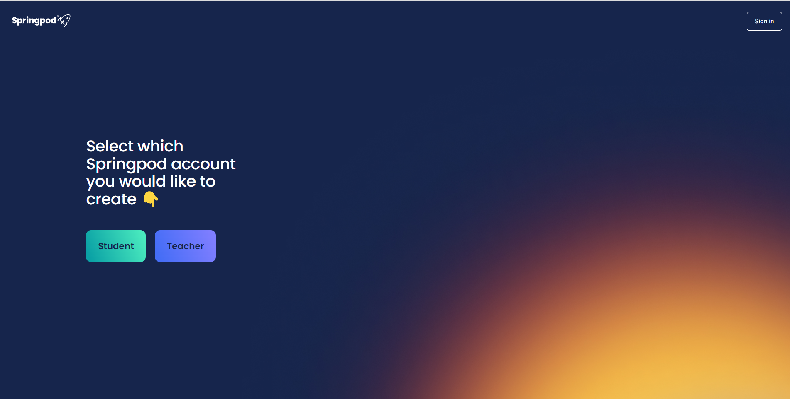
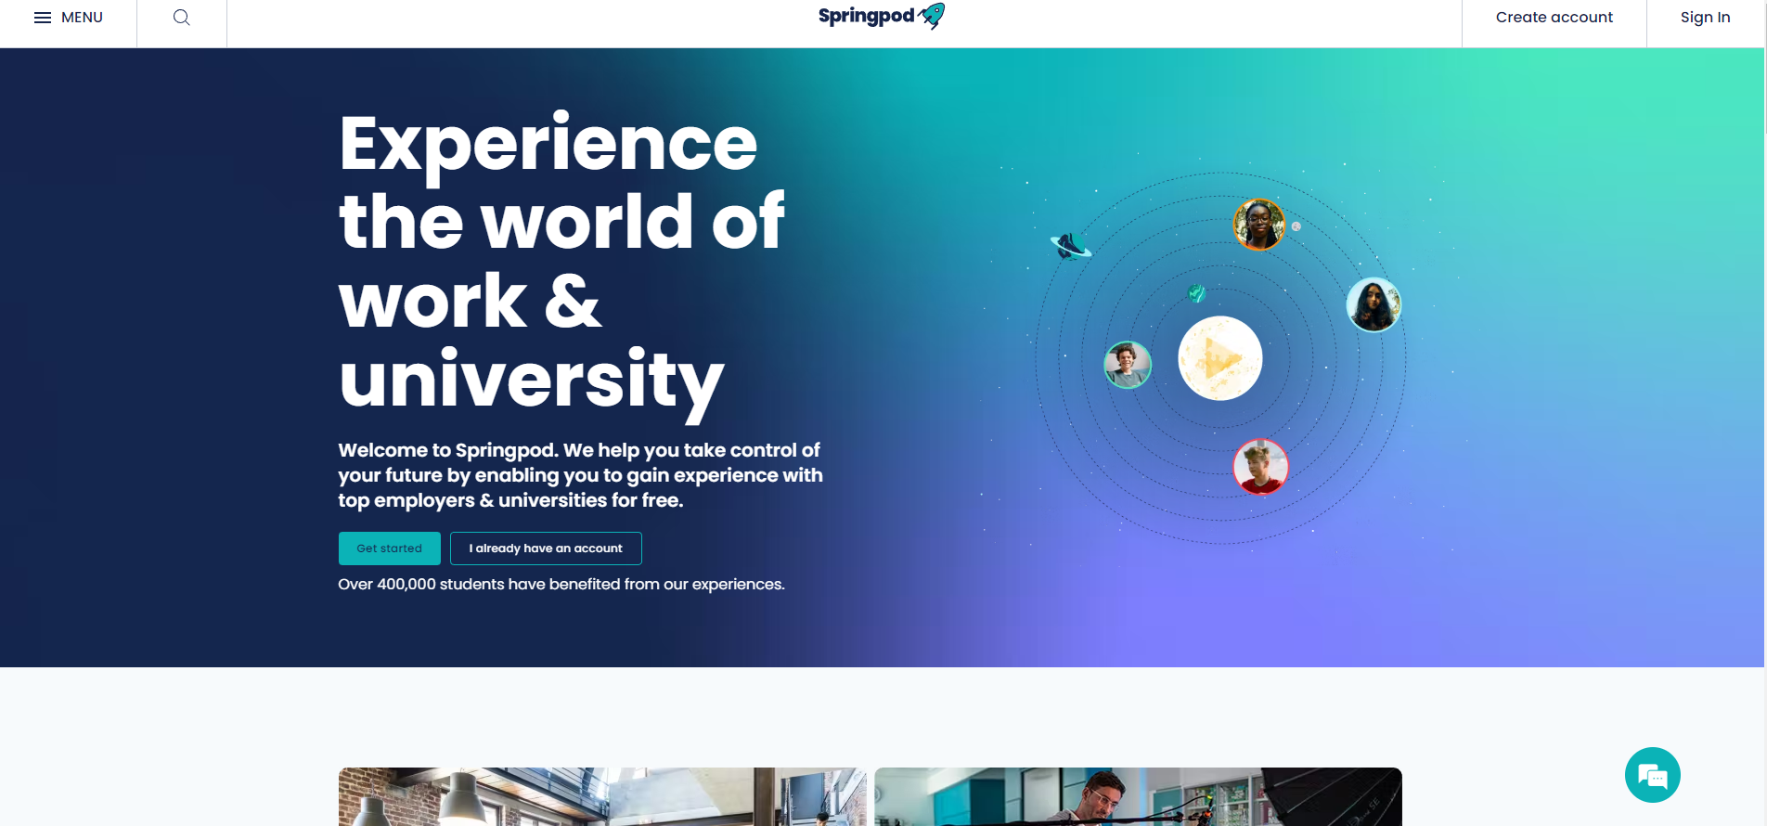
Create your account
Go to www.springpod.com
Click ‘Create Account’ in the top right corner
Select Student

Slide 10
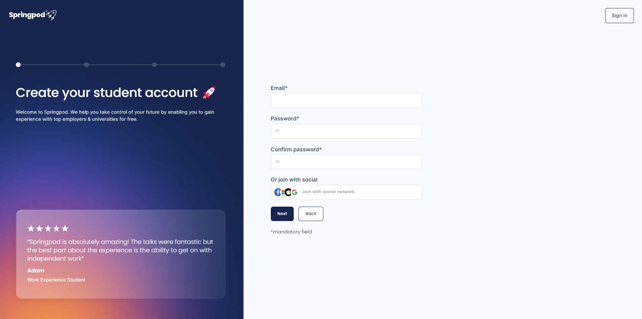
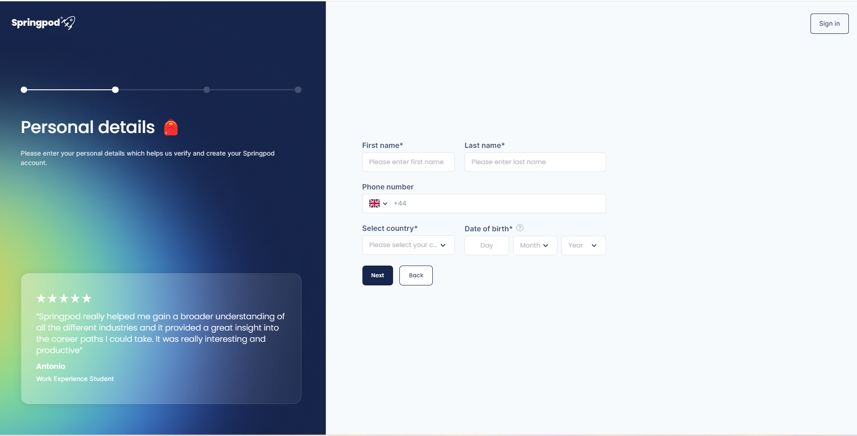
4. Add an email and create a password
5. Complete ‘Personal Details’

Slide 11
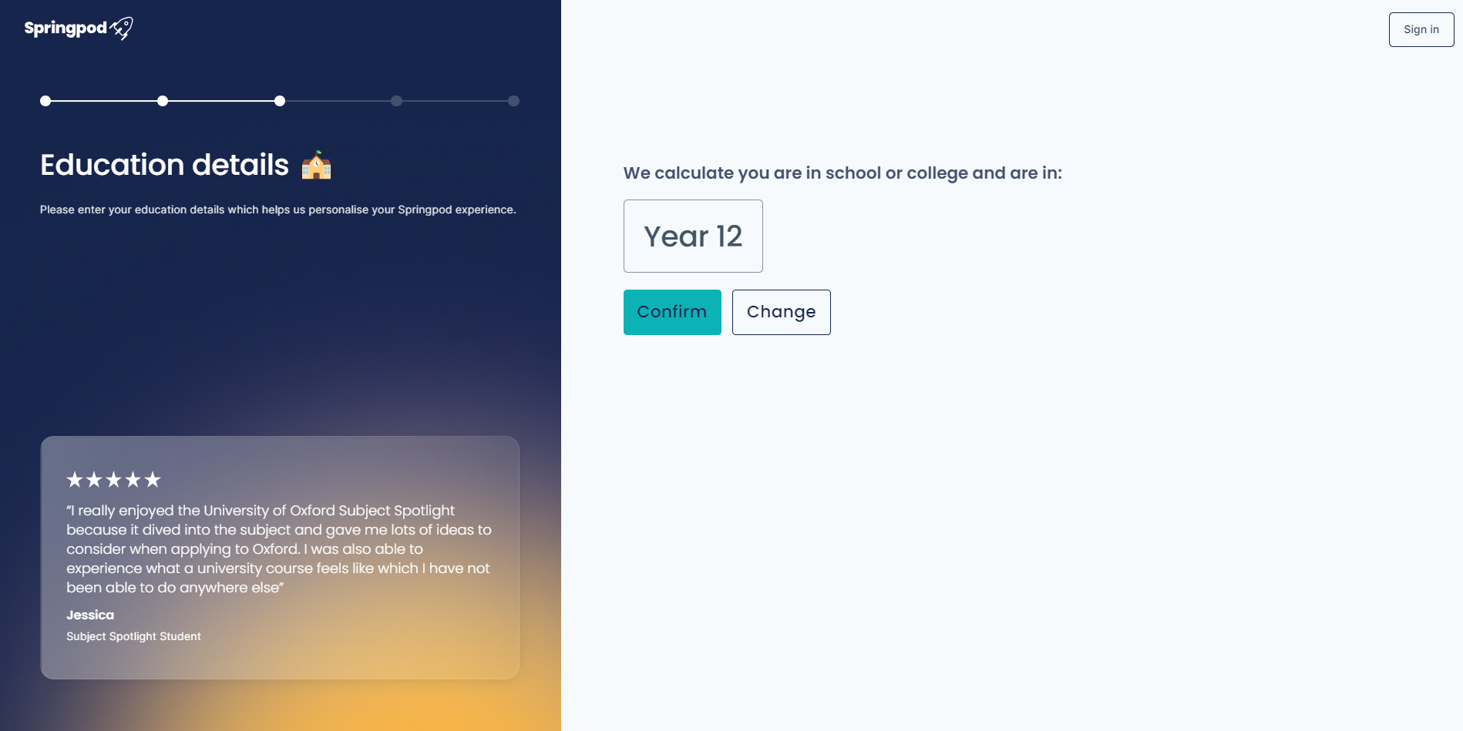
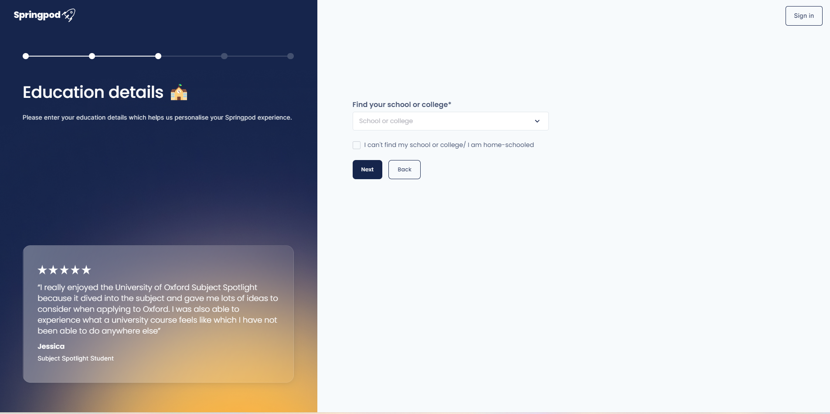
6. Confirm your Year Group
7. Find your School or College

Slide 12
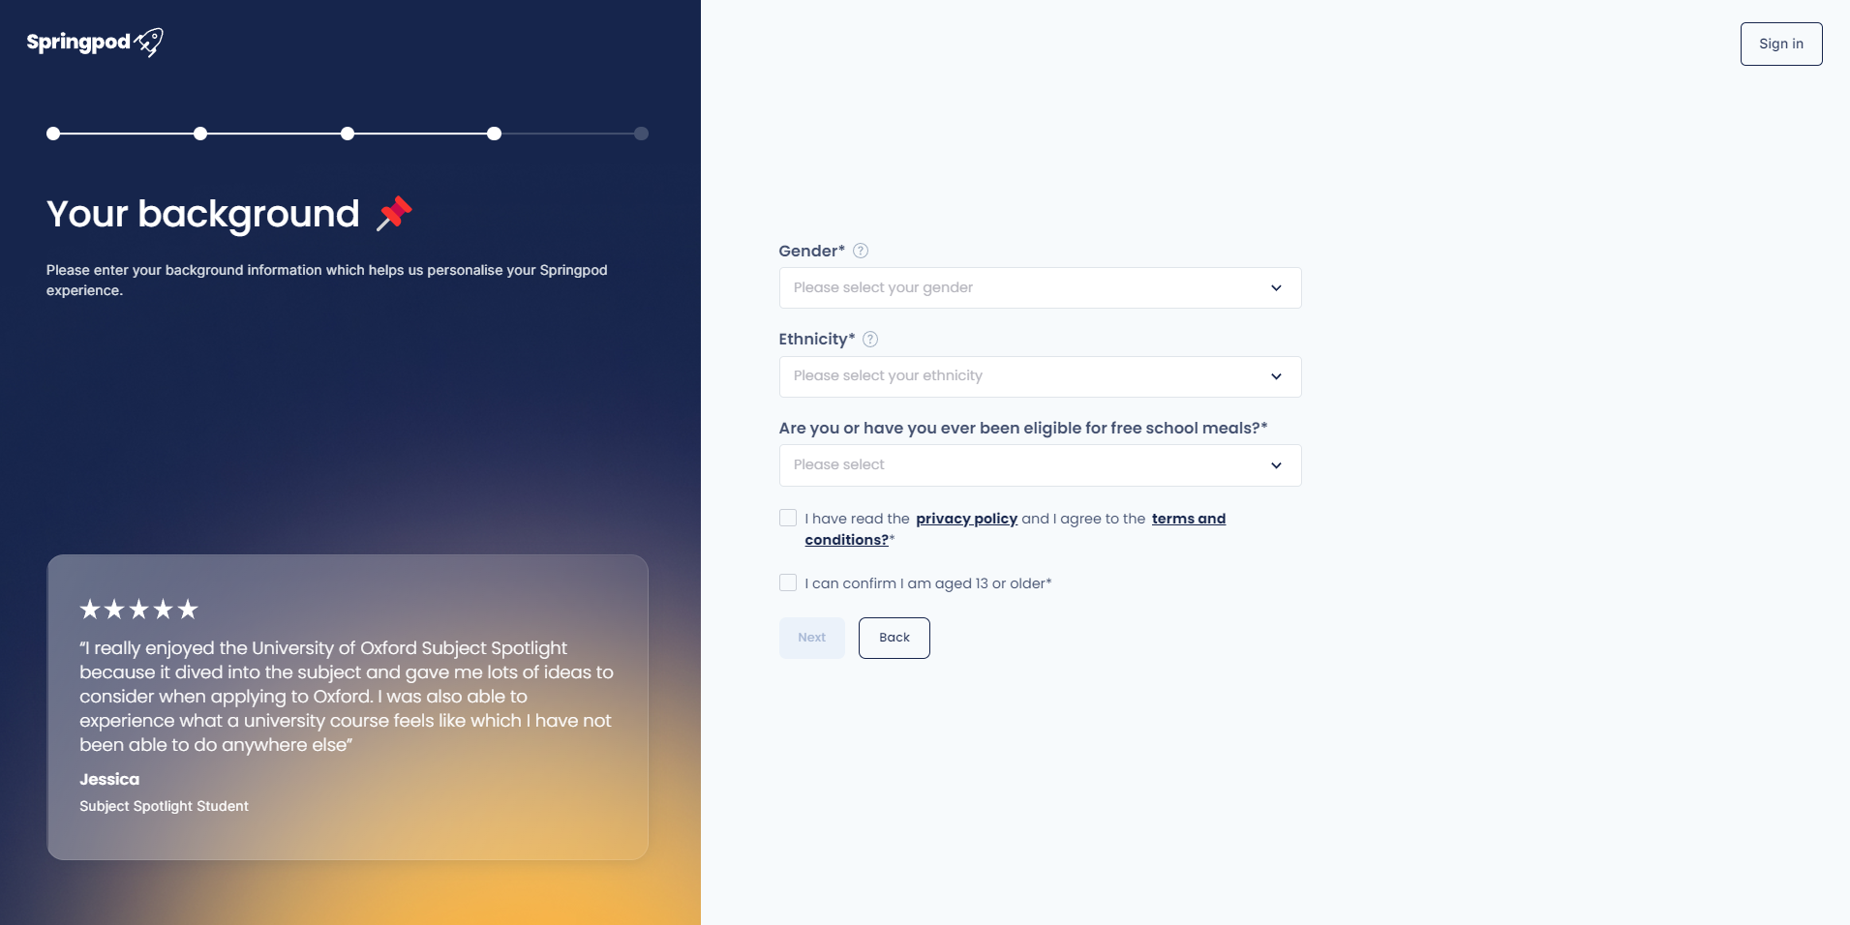
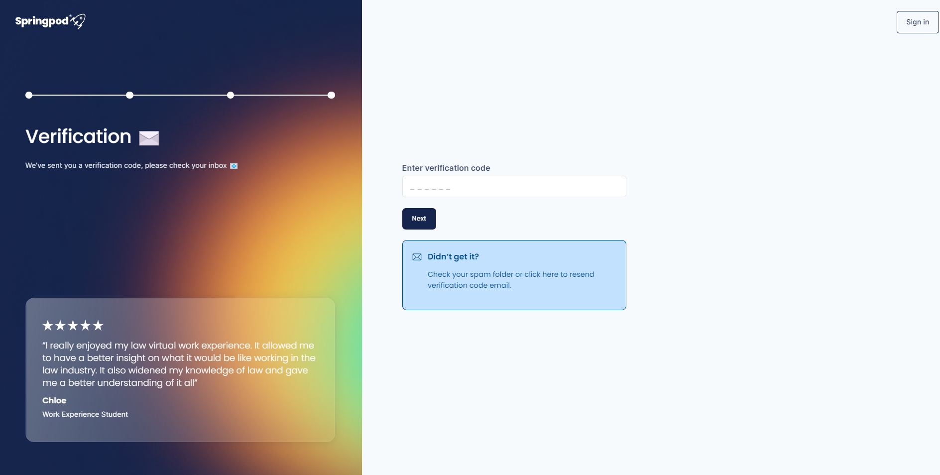
8. Complete your background
You can prefer not to say
9. Check your email for a verification code
Don’t forget to check your spam folder

Slide 13
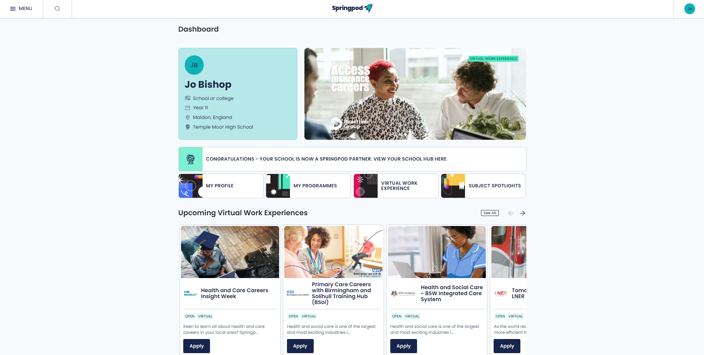
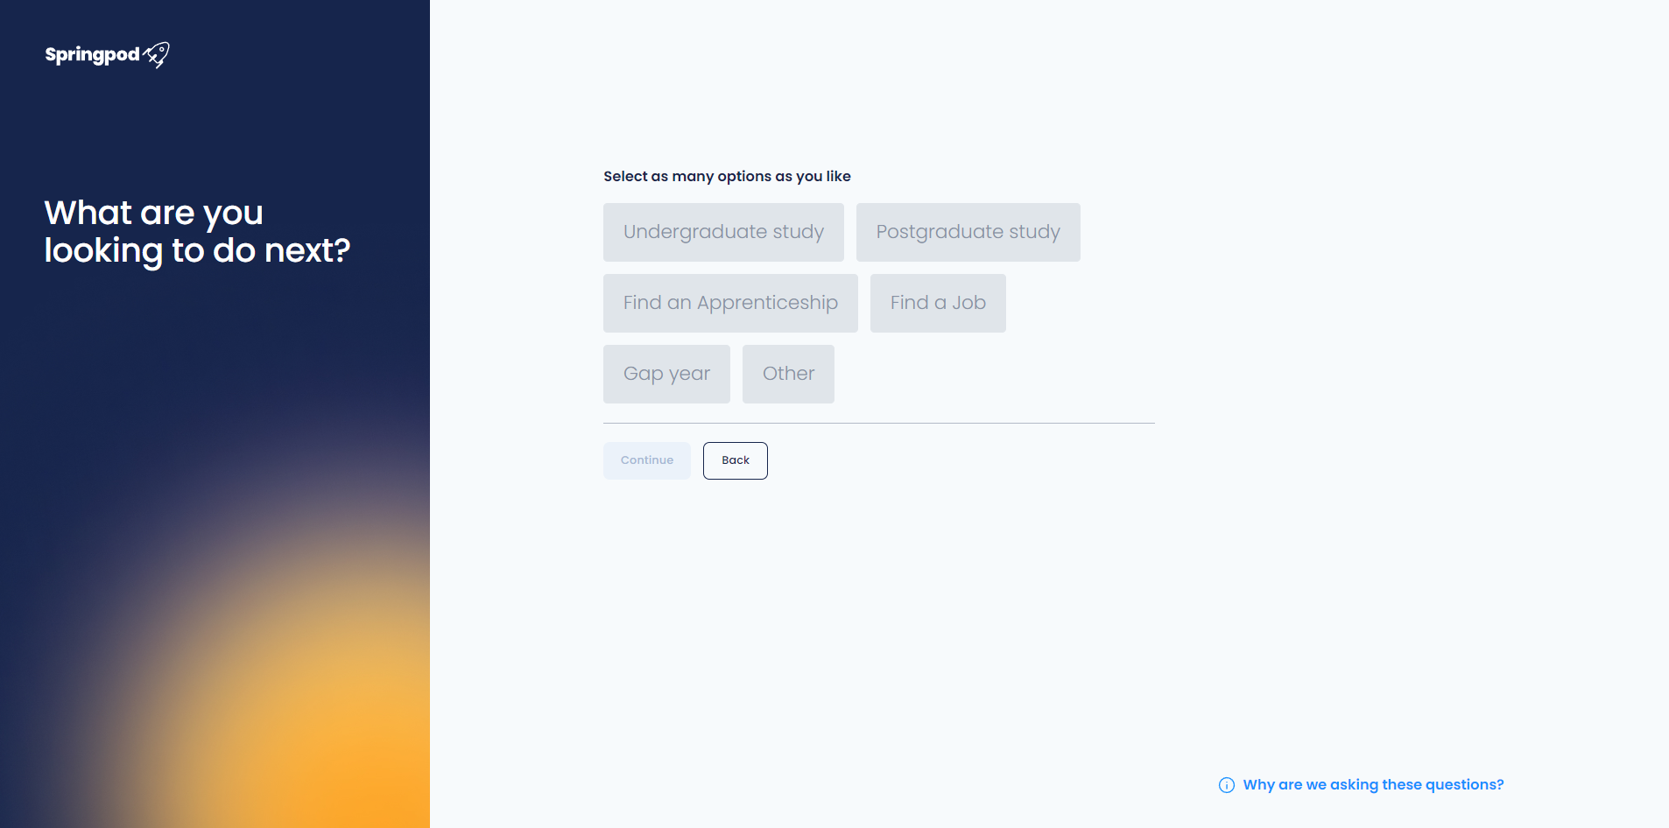
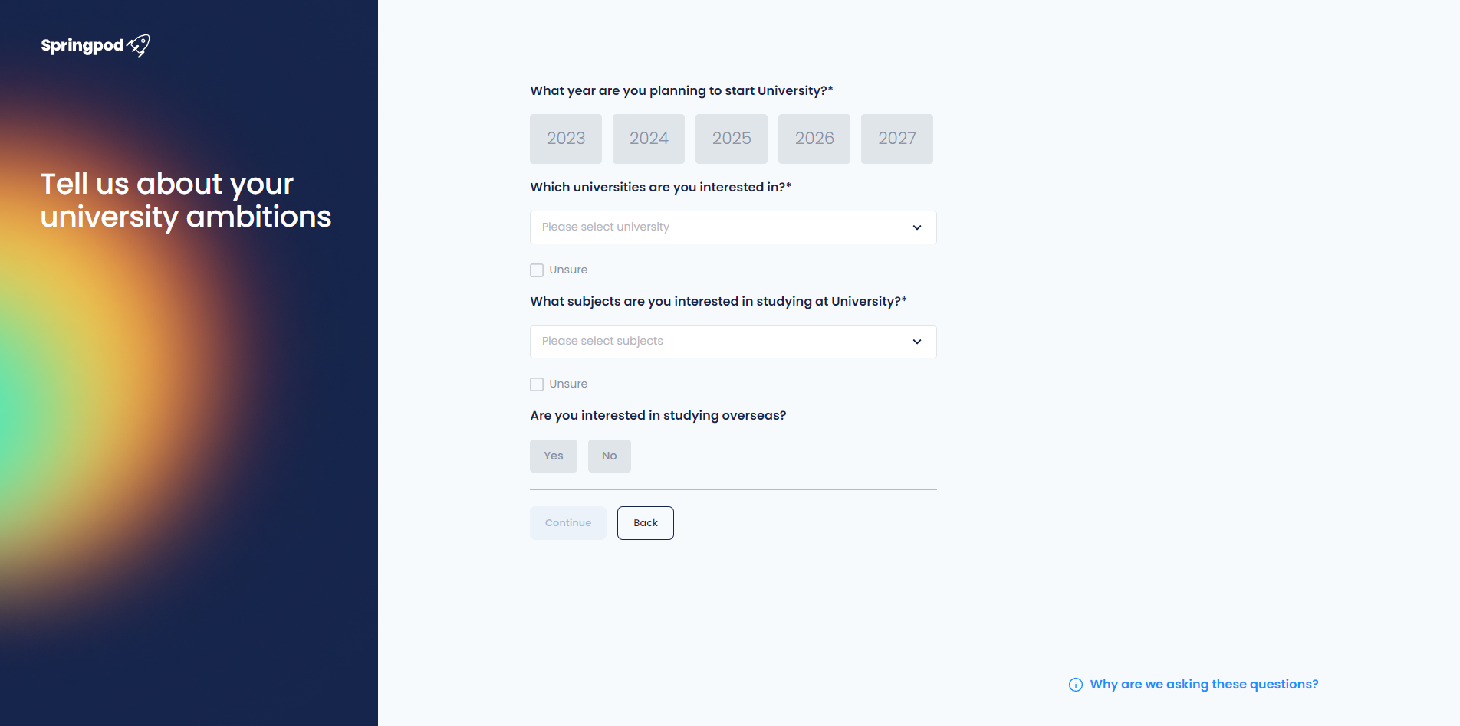
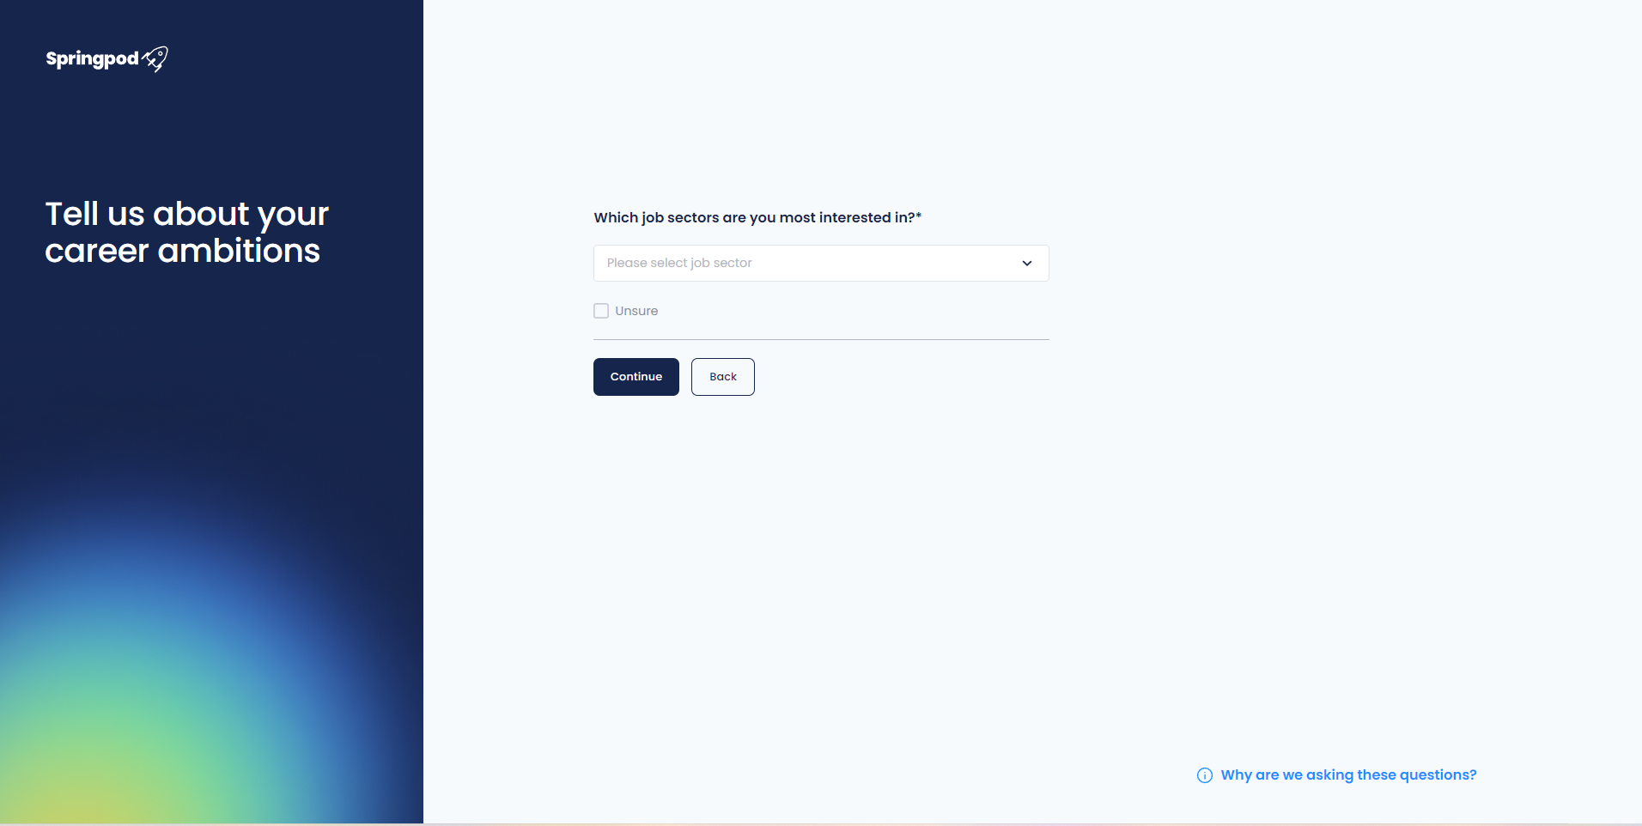
10. You can now go to your Dashboard and you will be prompted to complete your profile to personalise your Springpod experience

Slide 14
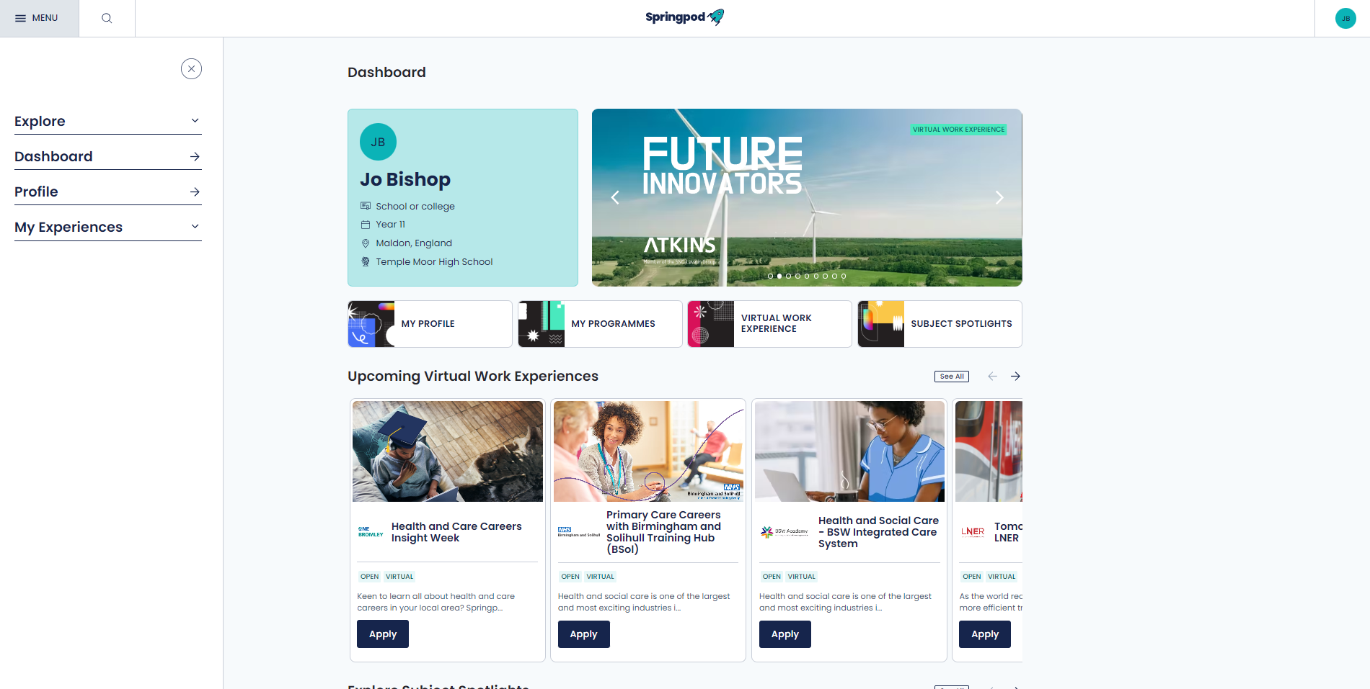
Welcome to Springpod!
This is your Dashboard which will feature the latest opportunities
You can add/edit your profile

